Slide 1
Image application

Slide 2
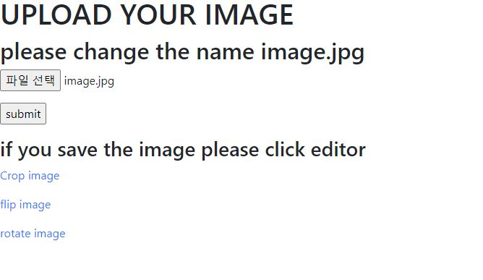
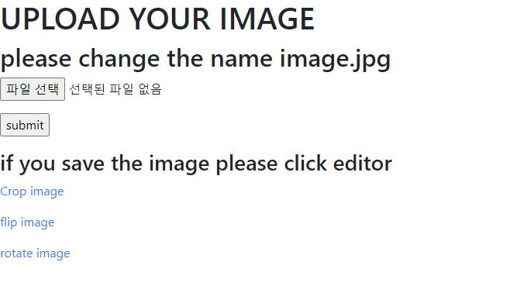
1. Save the image (All editor same)

Slide 3
Otsu editor

Slide 4
Otsu

Slide 5
Crop_Flip_Rotate_editor
Crop, Flip, Rotate

Slide 6
Crop

Slide 7
Flip

Slide 8
Rotate

Slide 9
Draw Editor
Draw Rectangle filled with color
Draw Rectangle
Draw text

Slide 10
Draw rectangle filled with color

Slide 11
Draw text

Slide 12
Draw Rectangle

Slide 13
Filter editor
Median, gaussian

Slide 14
Median filter

Slide 15
Gaussian Filter

Slide 16
RGBHSV
RGB, HSV

Slide 17
RGB

Slide 18
HSV

Slide 19
Canny editor

Slide 20
Canny

